Slide 1
A NEW TYPE OF TEACHER AND LABOR LEADER
LEAGUE OF EDUCATION VOTERS 3RD ANNUAL ACTIVIST TRAINING DAY
JANUARY 12, 2013 @edvoters @TeachersUtdWa

Slide 2
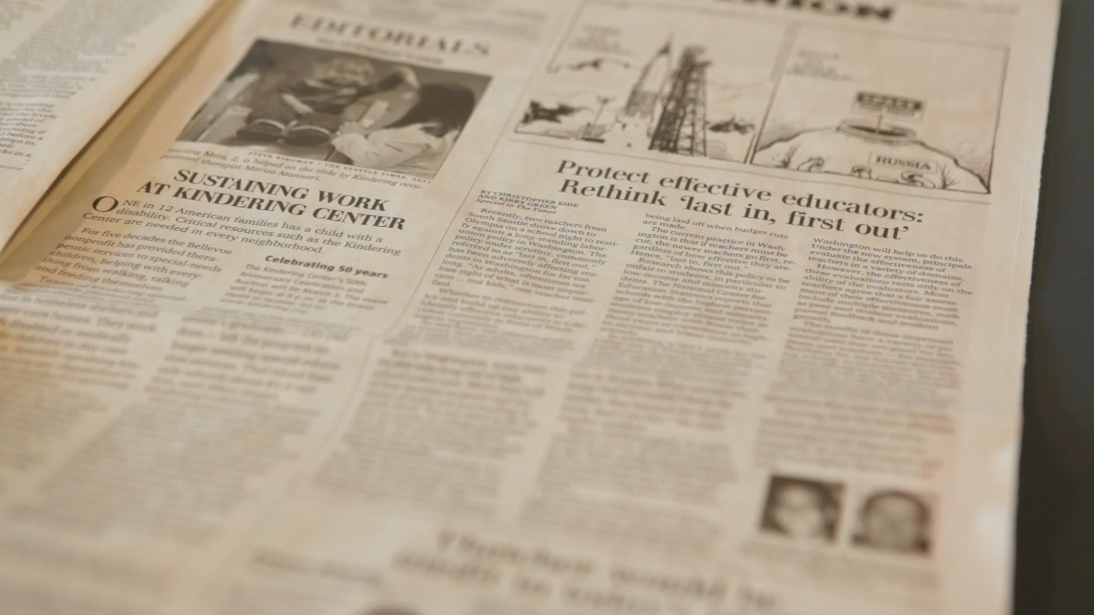
AGENDA
Part 1: Why Teachers Unionized
Part 2: “State of the Unions”
Part 3: The New Majority
Part 4: Innovations in Teacher Leadership
@TeachersUtdWa
www.teachersunitedwa.org
POWERFULEDUCATORS. POWERFULVOICE.

Slide 3
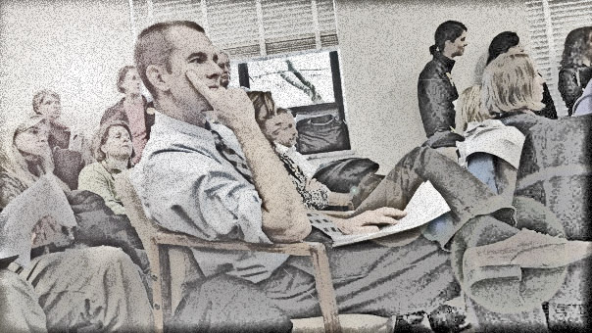
Factory worker salary outpacing teacher salary (teachers made $52/week in 1953)
Discriminatory practices
Politically-based or arbitrary dismissals
WHY TEACHERS UNIONIZED
@TeachersUtdWa
www.teachersunitedwa.org
POWERFULEDUCATORS. POWERFULVOICE.

Slide 4
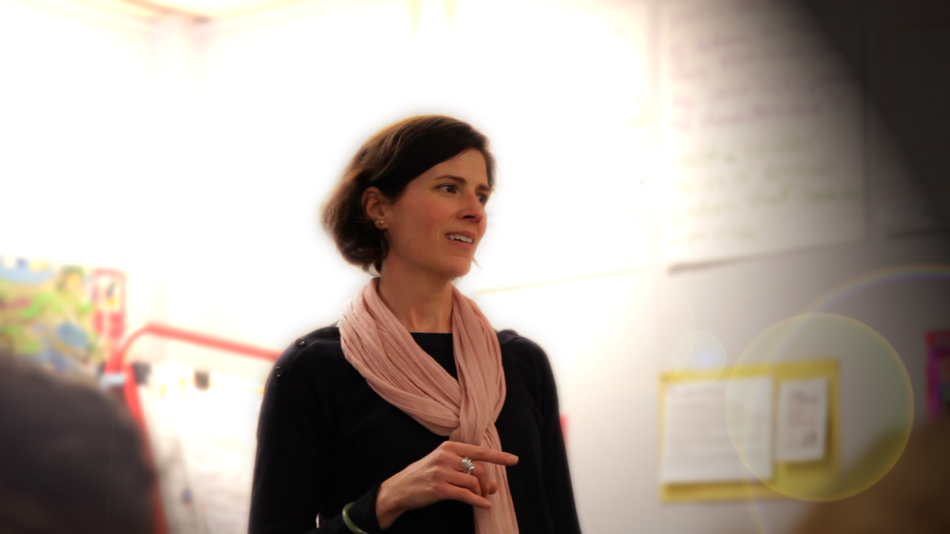
77%* say without collective bargaining, the working conditions and salaries of teachers would be much worse
81%* say without a union, teachers would be vulnerable to school politics or administrators who abuse their power
*Source:
Trending Towards Reform: Teachers
Speak on Unions and the Future of the Profession. Ed Sector. (2012)
@TeachersUtdWa
www.teachersunitedwa.org
POWERFULEDUCATORS. POWERFULVOICE.

Slide 5
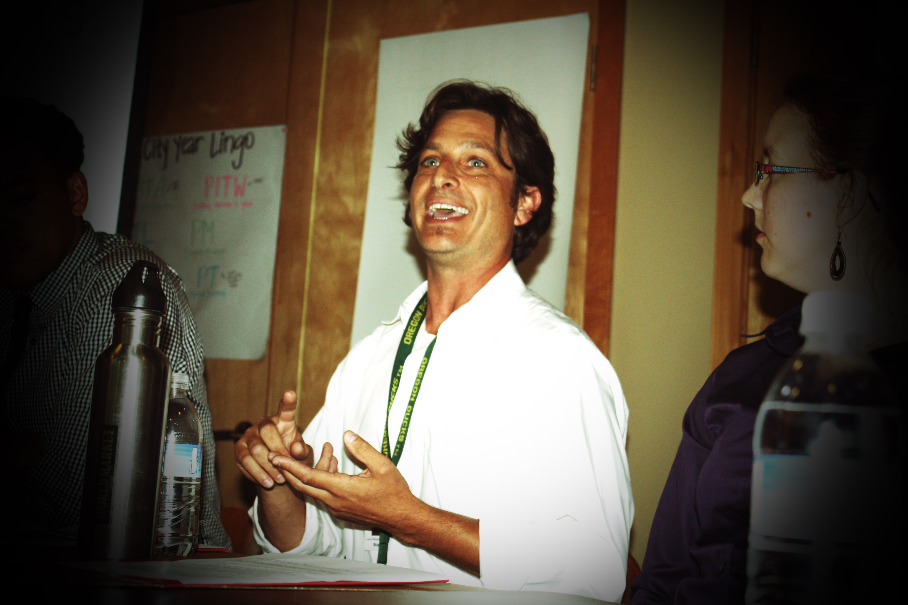
In 2011, only 42% of teachers say unions should stick to traditional union issues such as protecting salaries, benefits, and jobs.
(52% in 2007*)
In 2011, 43% of teachers say unions should put more focus on issues such as improving teacher quality and student achievement. (32% in 2007*)
Source: Trending Towards Reform: Teachers
Speak on Unions and the Future of the Profession. Ed Sector. (2012)
@TeachersUtdWa
www.teachersunitedwa.org
POWERFULEDUCATORS. POWERFULVOICE.

Slide 6
Currently, there are more first-year teachers in America than teachers of any other experience level.²
For the first time in decades, teachers with 10 years of experience or fewer constitute over 50% of the teaching
force.¹
National Center for Education Statistics. (2010) Schools and Staffing Survey.
Ingersoll, R. & Merrill, L. (2012) Seven Trends: The Transformation of the Teaching Force.
@TeachersUtdWa
www.teachersunitedwa.org
POWERFULEDUCATORS. POWERFULVOICE.

Slide 7
TEACHING EXPERIENCE OF PUBLIC SCHOOL TEACHERS, 1987-88 AND 2007-08
Figure from Ingersoll, R. & Merrill, L. (2012). Seven Trends: The Transformation of the Teaching Force. Paper presented at the annual
meeting of the American Educational Research Association, Vancouver, Canada.

Slide 8
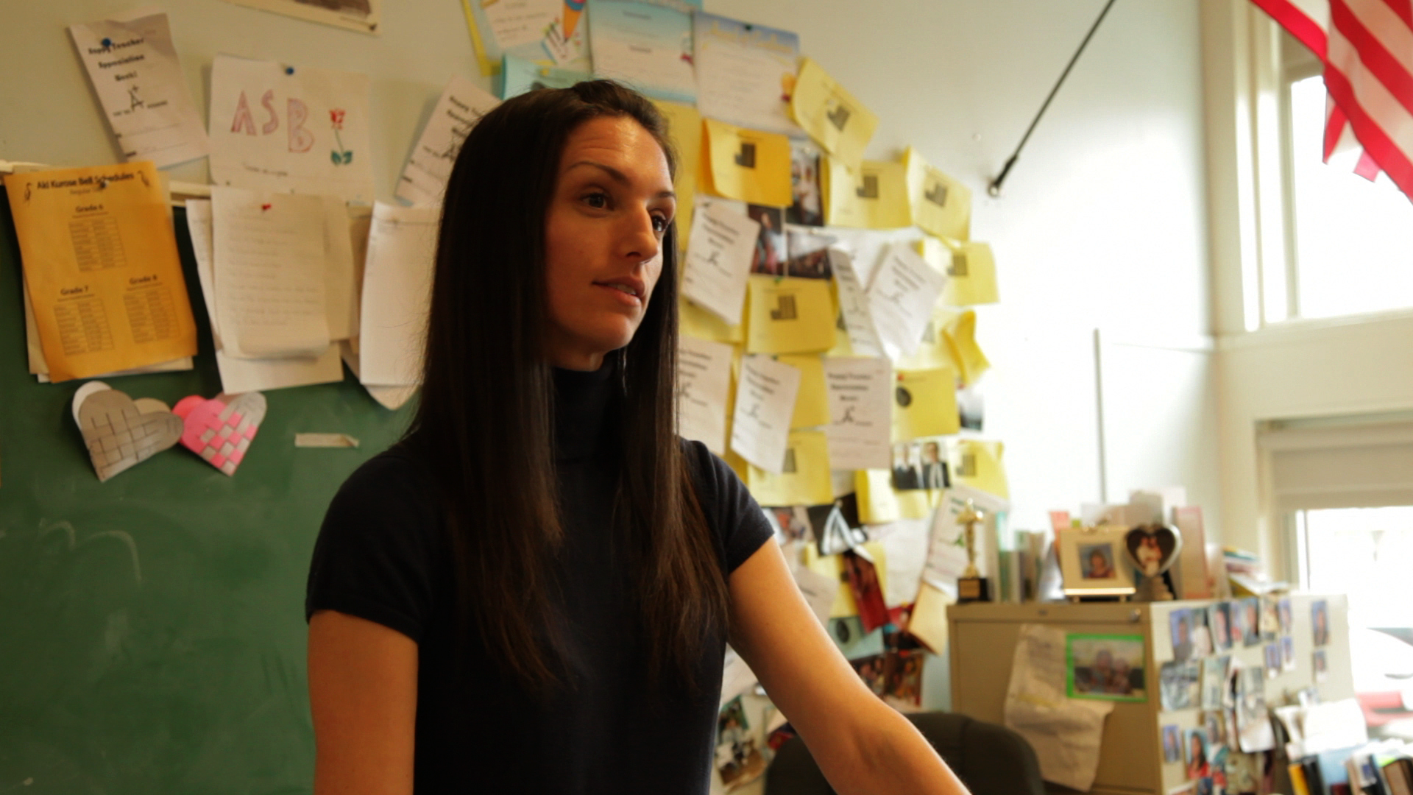
HIGH EXPECTATIONS FOR LEARNING
New Majority Veteran
3.8 3.3
BETTER SYSTEMS OF EVALUATION
New Majority Veteran
3.7 3.2
BETTER USE OF STUDENT DATA
New Majority Veteran
3.6 2.9
“THE NEW MAJORITY”
Source: Great Expectations: Teachers’ Views on Elevating the Teaching Profession. Teach Plus (2012).
@TeachersUtdWa
www.teachersunitedwa.org
POWERFULEDUCATORS. POWERFULVOICE.

Slide 9
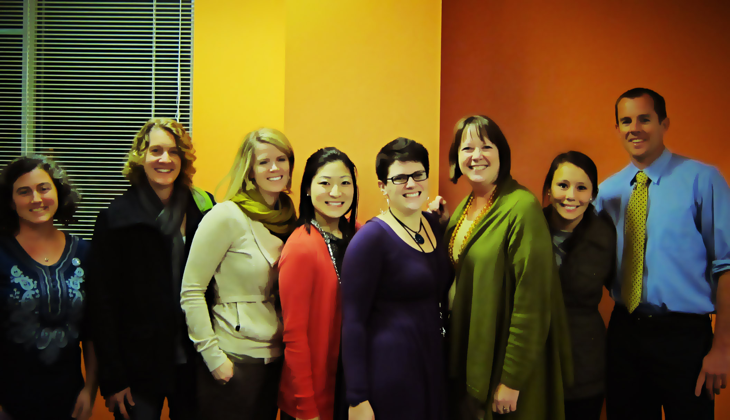
DISCUSSION QUESTION:
What aspirations do you have for teacher unions?
@TeachersUtdWa
www.teachersunitedwa.org
POWERFULEDUCATORS. POWERFULVOICE.

Slide 10
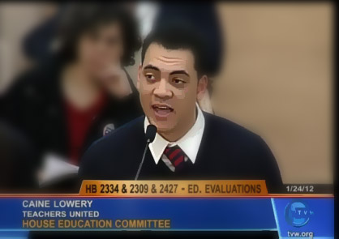
*Advocacy campaigns by teachers
*Teacher-generated policy papers
*Visits with elected officials
*Social media campaigns
INNOVATIONS IN TEACHER VOICE
@TeachersUtdWa
www.teachersunitedwa.org
POWERFULEDUCATORS. POWERFULVOICE.

Slide 11
INNOVATIONS IN UNION LEADERSHIP
LOS ANGELES: INCREASED PARTICIPATION IN UNION GOVERNING BODY (NewTLA)
NEW YORK CITY: TEACHERS REDEFINING THE ROLE OF CHAPTER CHAIR (Educators 4 Excellence)
BOSTON: TEACHERS CALLING FOR EASIER UNION VOTING PROCEDURES (Teach Plus)
WASHINGTON STATE: INCREASING UNION PARTICIPATION IN LEADERSHIP POSITIONS BY REFORM-MINDED TEACHERS (TU)
@TeachersUtdWa
www.teachersunitedwa.org
POWERFULEDUCATORS. POWERFULVOICE.

Slide 12
INNOVATIONS IN UNION CONTRACTS
Teachers
Union
District
@TeachersUtdWa
www.teachersunitedwa.org
POWERFULEDUCATORS. POWERFULVOICE.

Slide 13
DISCUSSION QUESTION:
What is your role in helping teacher unions to reach your aspirations for them?
@TeachersUtdWa
www.teachersunitedwa.org
POWERFULEDUCATORS. POWERFULVOICE.

Slide 14
THANKS FOR STAYING FOR THE WHOLE THING!
LEAGUE OF EDUCATION VOTERS 3RD ANNUAL ACTIVIST TRAINING DAY
JANUARY 12, 2013 @edvoters @TeachersUtdWa

